Slide 1

Face recognition Project
SS Team
10/11/2024

Slide 2
TABLE OF CONTENT
Define the Problem
Data Collection and Preprocessing
Model Selection and Training
Model Evaluation
Build Training and Inference Pipelines
Create a Face Gallery and identification

Slide 3
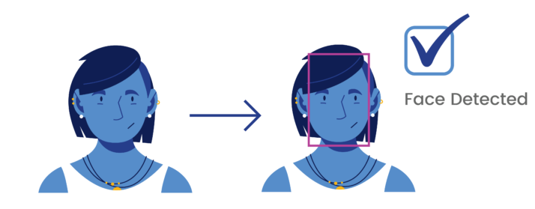
Define the Problem
Problem Description
→ Objective: Develop a facial recognition model that accurately identifies individuals based on their facial features.
Input: An image of a person's face that needs to be recognized.
Output: The name of the identified individual.
Application
Attendance Integration: Link the facial recognition system with attendance management for automatic tracking.
Real-Time Recognition: Allow identification of individuals upon entry.

Slide 4
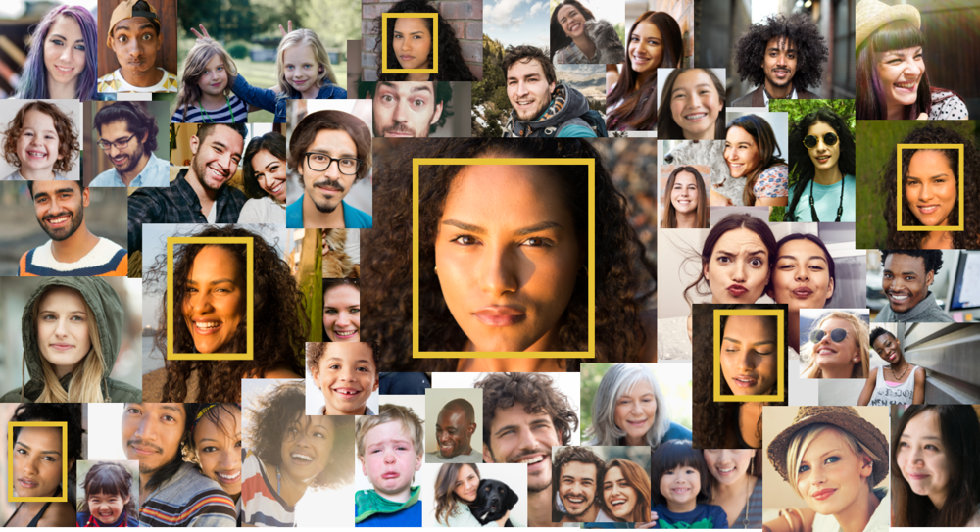
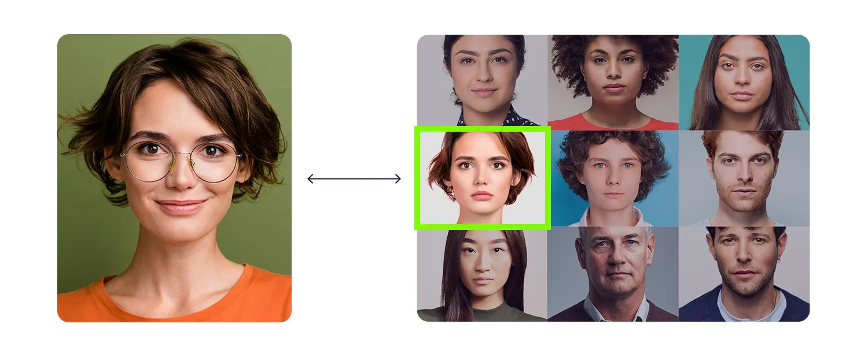
Define the Problem
Key Requirements:
Identify Users: The system should recognize individuals based on a pre-registered list of identities.
Face Classification: Distinguish between faces and assign them to specific identities.
Scope: The system will focus on facial recognition under specific environmental conditions (e.g., good lighting, frontal view images).

Slide 5
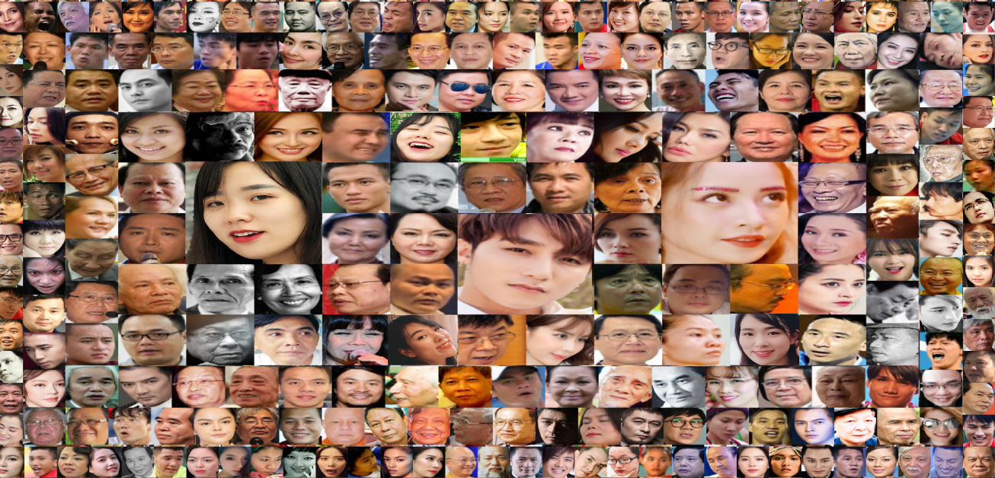
2. Data Collection and Preprocessing
Data Collection: Use available facial datasets or create a custom dataset. Some common sources include:
LFW (Labelled Faces in the Wild): Contains natural face images in various contexts. → validation
VGGFace: Offers a large number of face images from different individuals → pretrained model
VietNam celeb → fine-tune
Custom data → fune-tune

Slide 6
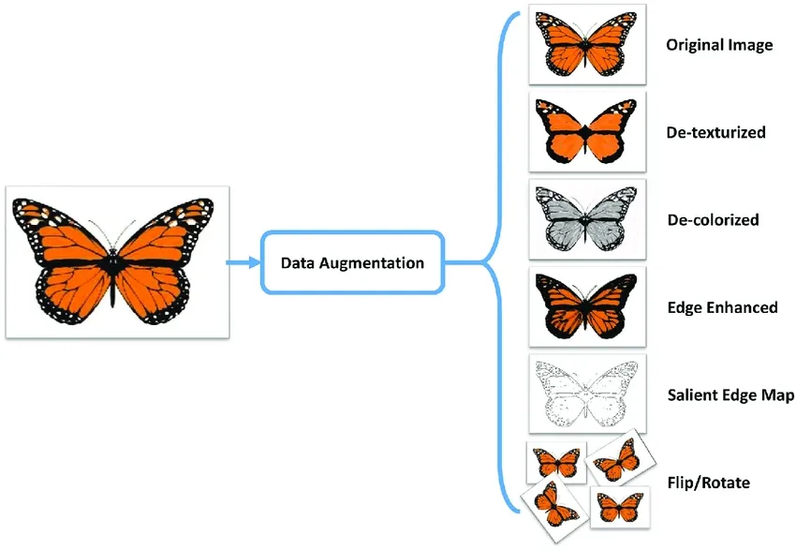
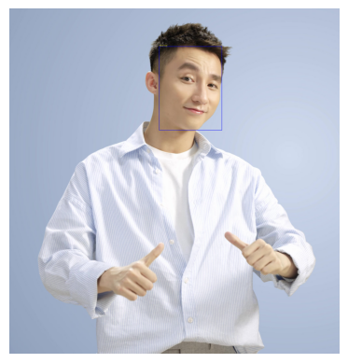
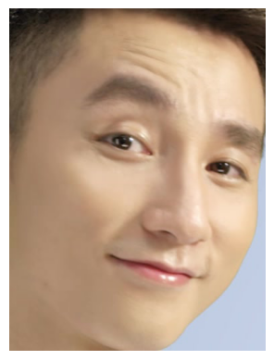
2. Data Collection and Preprocessing
Preprocessing:
Check consistent: Does the photo have a human face? or Are the photos in the wrong folder?
Face crop: use detection model to crop face (yolo , mtcnn)
Data Augmentation: Apply transformations like rotation, flipping, and lighting adjustments to increase dataset diversity.(option)

Slide 7
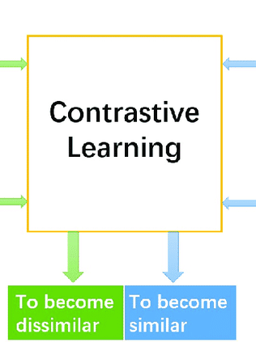
3. Model Selection and Training
Face detection: use pretrained model
Yolo → fast
Mtcnn → return image tensor not bounding box
Face recognition: Use embedding image method:
inceptionresnet : Deep CNN networks well-suited for facial feature recognition
Resnet: Common for image recognition tasks.
Transfer Learning: Use pre-trained models (e.g., ResNet) and fine-tune on we specific facial dataset.
Face Embedding: Instead of direct classification, convert faces into embedding vectors and compare their distances to determine similarity.

Slide 8
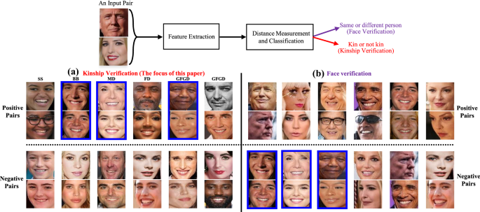
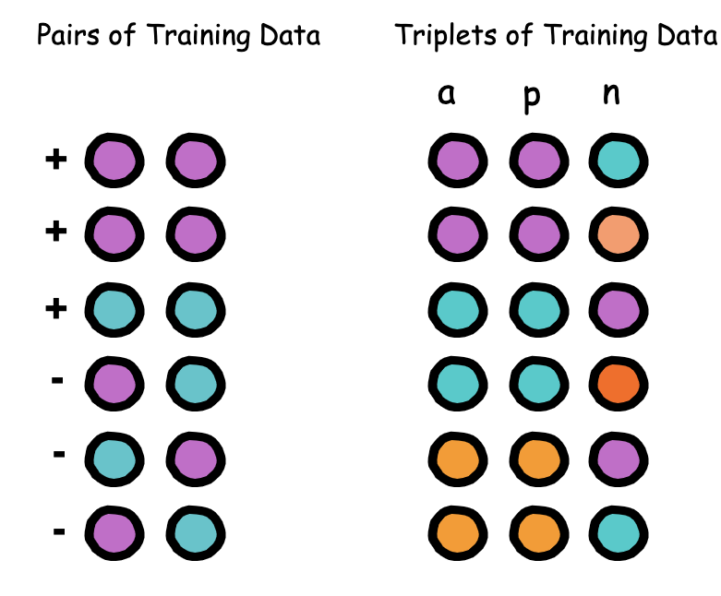
3. Model Selection and Training
Dataset and dataloader
Select triple image in folder (anchor, positive and negative)
Transforms data
Create dataloader ….

Slide 9
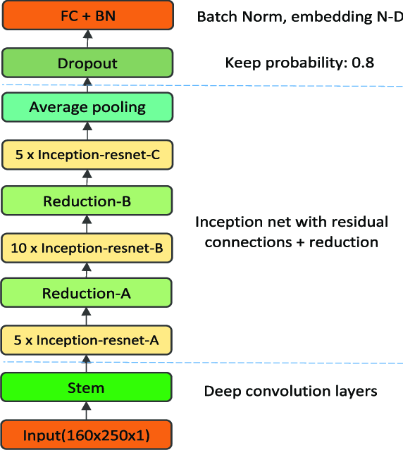
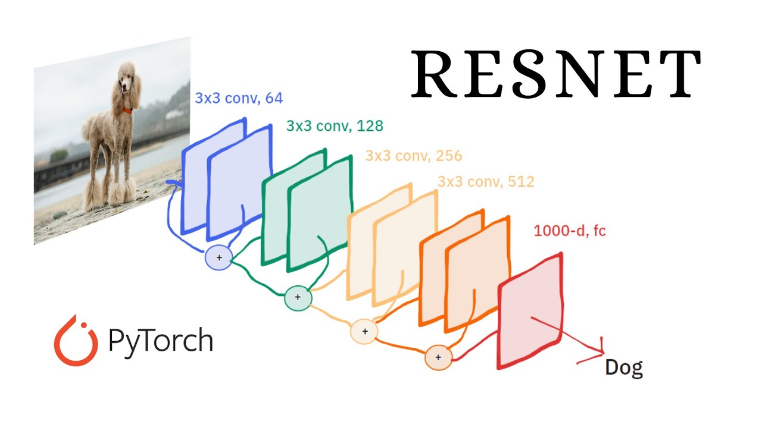
3. Model Selection and Training
Model overview

Slide 10
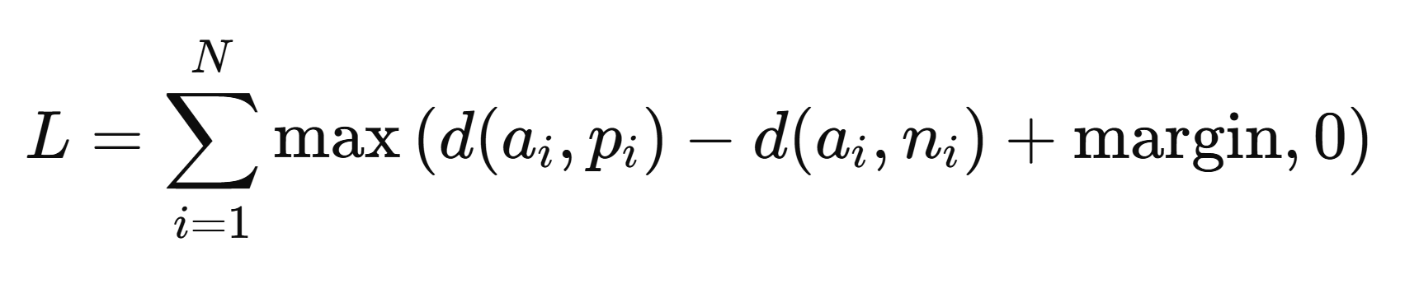
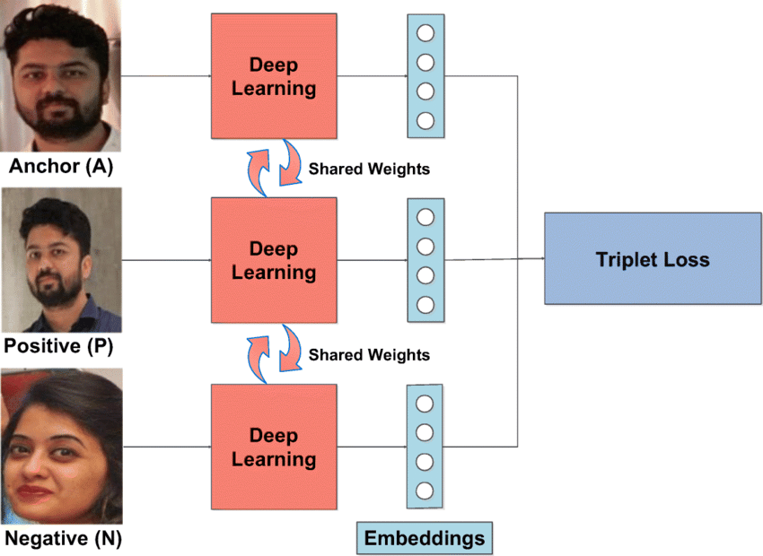
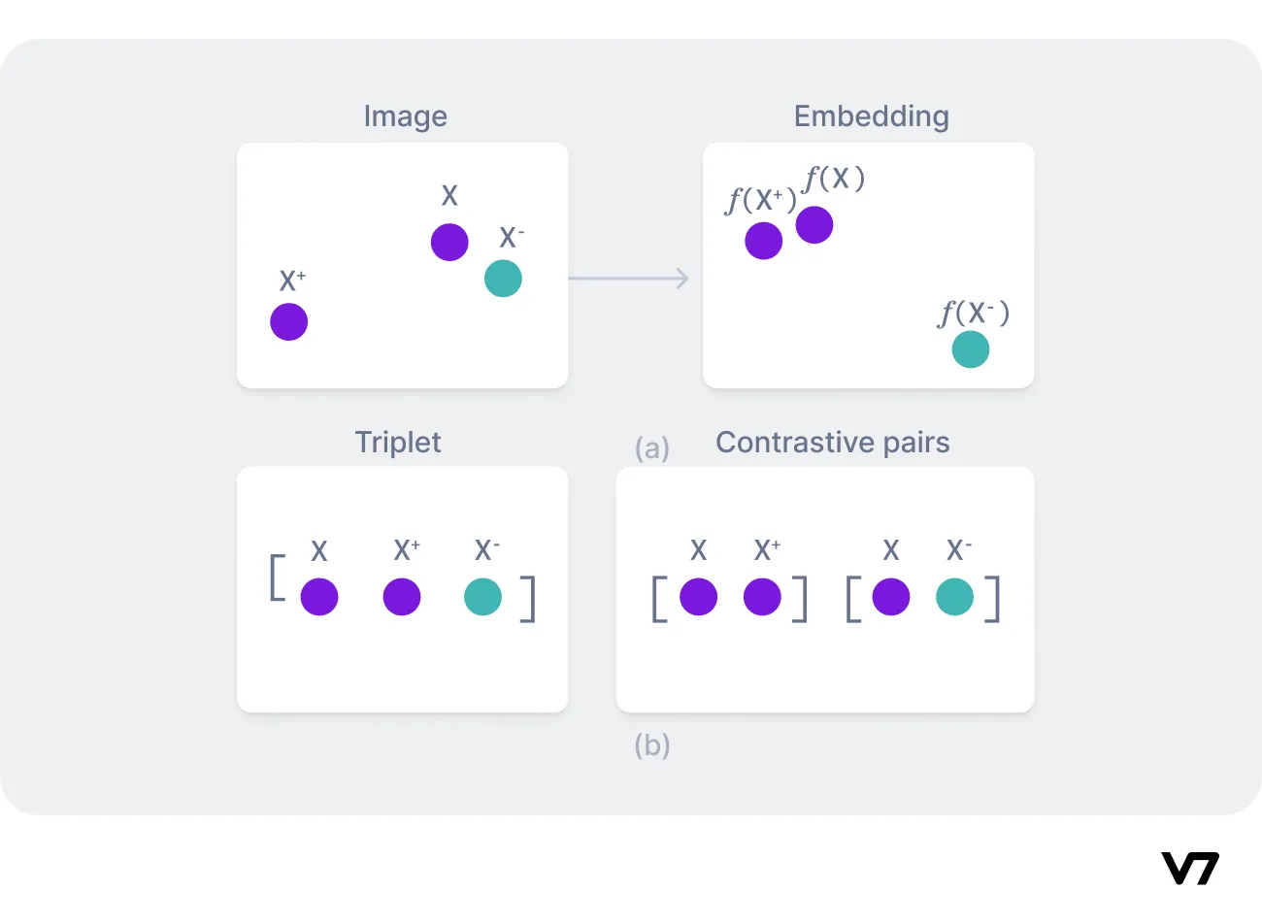
3. Model Selection and Training
Trainning loss

Slide 11
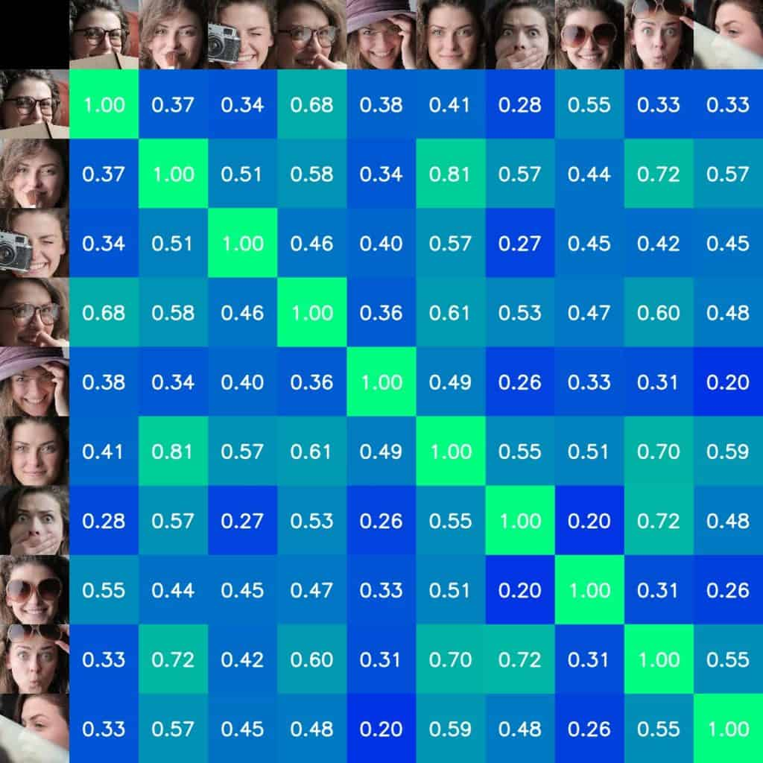

4. Model Evaluation
Validation in val_dataset
Use many metric
Accuracy: The probability of correct predictions on the test set.
Recall and Precision: Measures the model’s ability to correctly detect faces (Recall) and accuracy in identifying faces correctly (Precision).
F1-Score: Overall metric balancing precision and recall….

Slide 12
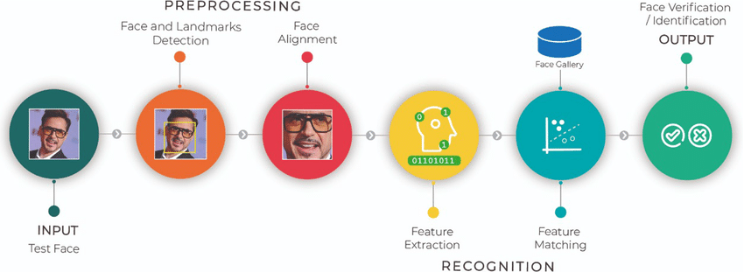
5. Build Training and Inference Pipelines
Training model with many hyper param and config → select best model
Pinelines

Slide 13
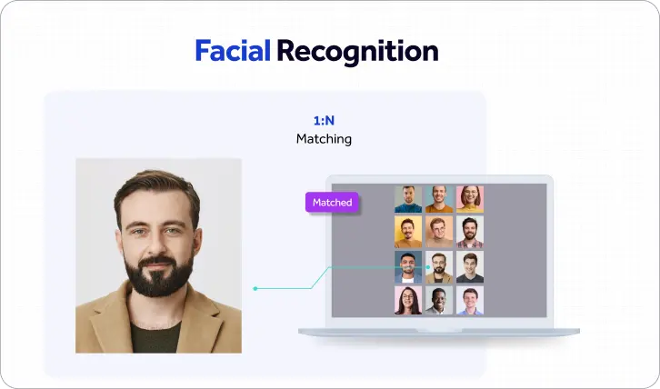
6. Create a Face Gallery and identification
Build a Folder include collection of individuals that need to be identified
Create Vector imbedding and save
Infer single image or video (compare with collection vector select the most similar vector)

Slide 14


